Slide 1

Music and Mental Health
By
Angela Cavalli
Can listening to music improve mental health for those suffering from Depression, Anxiety, OCD and Insomnia?

Slide 2
About the Data Set…
Obtained from Kaggle.com
735 participants
Ages ranged from 14 to 89, diverse
Participants reported (and ranked severity of) one of more of the following mental health problems:
Depression
Anxiety
OCD
Insomnia

Slide 3
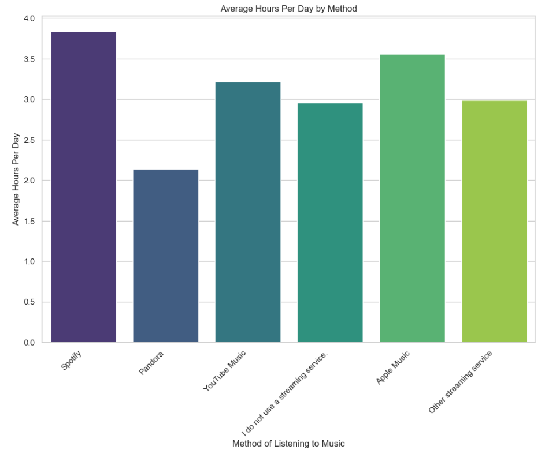
Participants used a variety sources of listening to music
Graph shows method and average hours per day used.

Slide 4
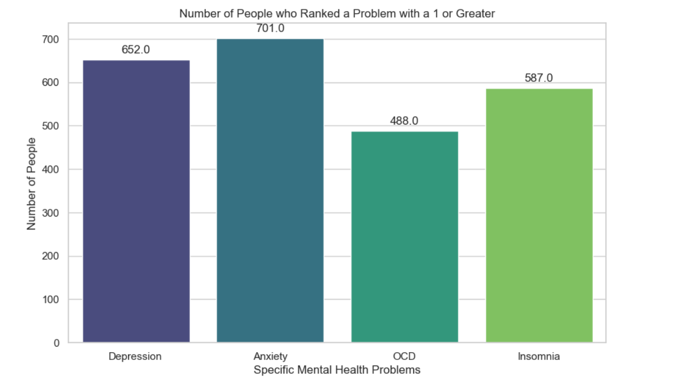
Anxiety was the most common problem, with Depression as a second most common.
I decided I would drill down on Anxiety.

Slide 5
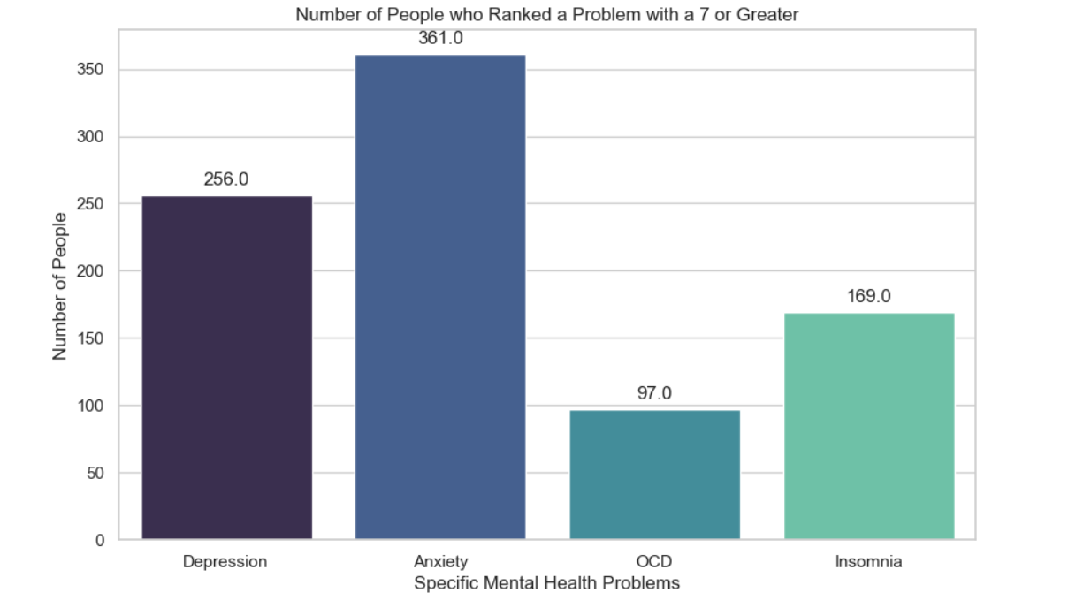
This chart shows number of people ranked that their problem as a 7 or greater. Again, Anxiety was the most prevalent. Almost half of the participants ranked their Anxiety as 7 or greater.

Slide 6
Question #1:
Did listening to music,
IMPROVE, WORSEN or have NO EFFECT on mental health problems?

Slide 7
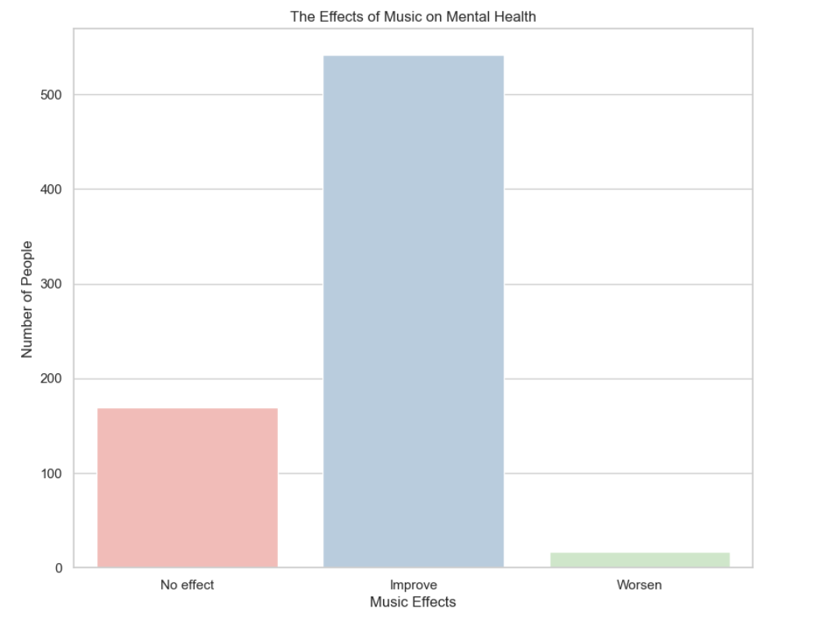
For over 500 participants who reported IMPROVEMENT after listening to music.

Slide 8
Did the amount of time listening to music matter?
Question #2:

Slide 9
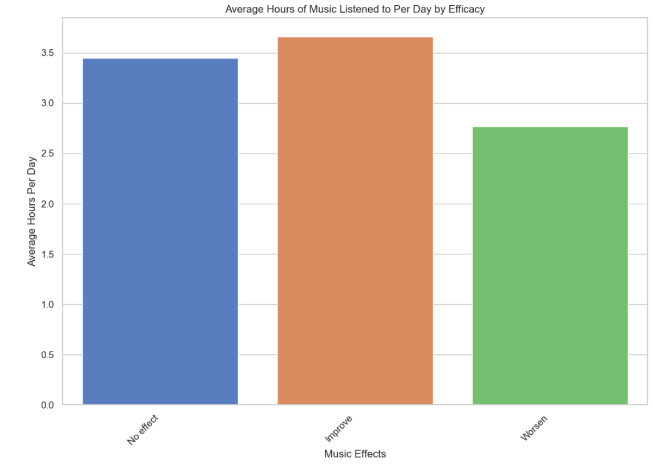
Average hours of music listened to, all participants, all conditions:
Improvement, 3.7 hours per day
No Effect, 3.4 hours per day
Worsened, 2.7 hours per day

Slide 10
For those suffering from Anxiety of a rank of 7 or greater, did listening to music improve the condition?
Question #3:

Slide 11
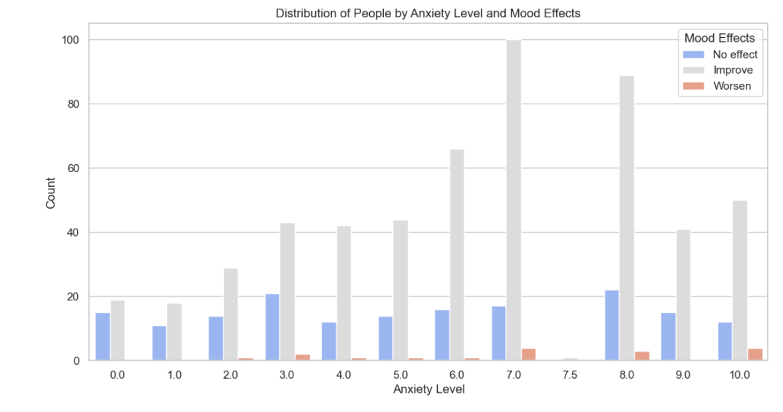
Anxiety rank 7 or greater
Yes improvement appears great.

Slide 12
Question #4:
What was the frequency of music genres listened to?

Slide 13
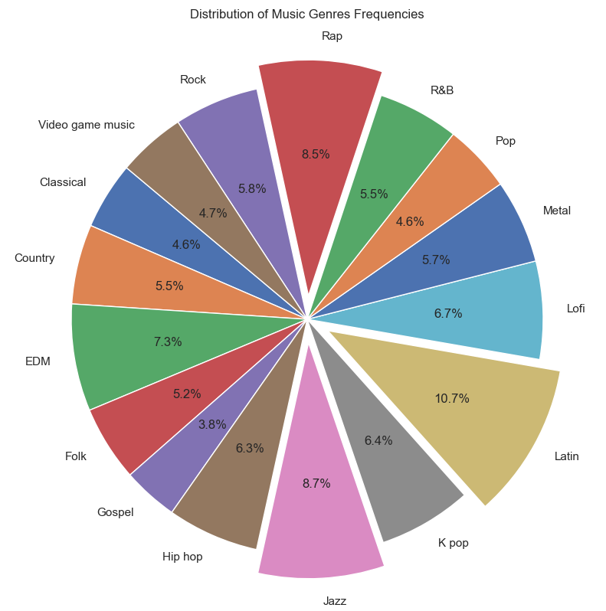
Participants had diverse music taste.
Top listened to genres were
Latin 10.7%
Jazz 8.7 %
Rap 8.5 %

Slide 14
Question #5:
Was a particular genre of music correlated with IMPROVEMENT?

Slide 15
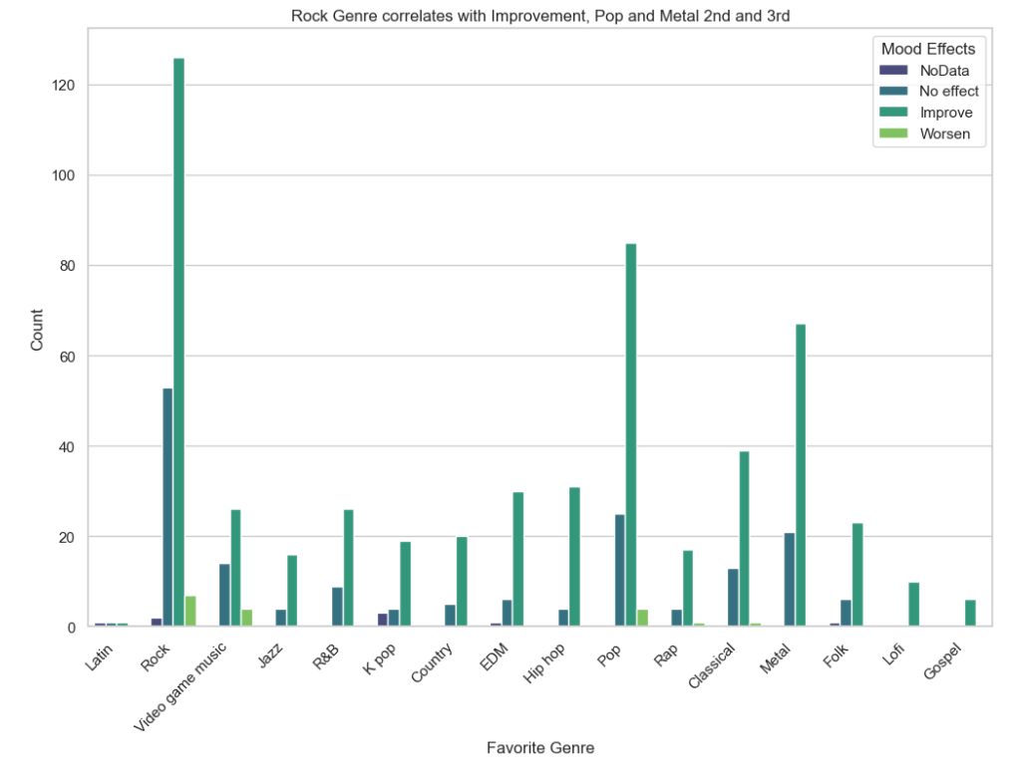
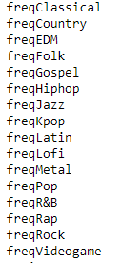
Even though participants listened to diverse genres of music:
Column names
ROCK genre produces most improvement, followed by POP, then METAL.

Slide 16
Findings
Listen to Rock music, your mood will improve,
(especially Anxiety).
A small percentage may experience worsening in mood.

Slide 17
Tools used
Jupyter Notebook
Python
Pandas
Seaborn
Matplotlib
Stats from scipy
Excel
Power Point
Microsoft Word
Chat GPT
GitHub
www.Kaggle.com

